Slide 1

Predicting the Severity of Car Accidents in Seattle
Bingqing Lu
September 22, 2020

Slide 2
Predict the possibility and severity of car accidents
The traffic problems are becoming one of the biggest headaches in our daily life.
People would really like a predict app to improve their safety and avoid unnecessary troubles.
The predict app can use the weather / road / light information from the users to predict the accidents.
Drives could plan their trips ahead and make the best decisions about the date/route... of their trips.

Slide 3
Data
Data were provided by SPD and recorded by Traffic Records in Seattle from 2004 to present.
The dataset has 194673 accident records and 37 attributes.
The dataset has a “severitycode” column, labeling the accidents’ severity, which can be used in supervised machine learning models.

Slide 4
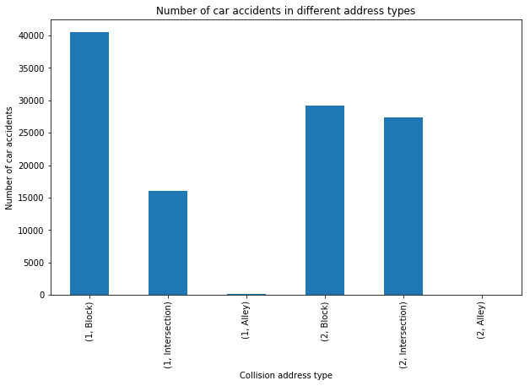
Exploratory Data Analysis
Bar chart for different collision address types in two severity levels 1 and 2

Slide 5
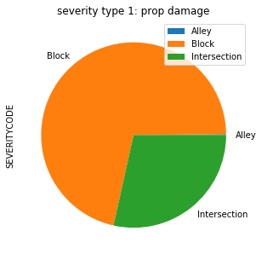
Pie chart for property damage accidents with different address types

Slide 6
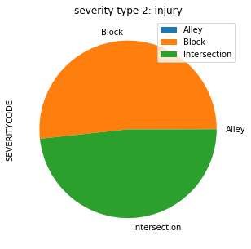
Pie chart for injury accidents with different address types

Slide 7
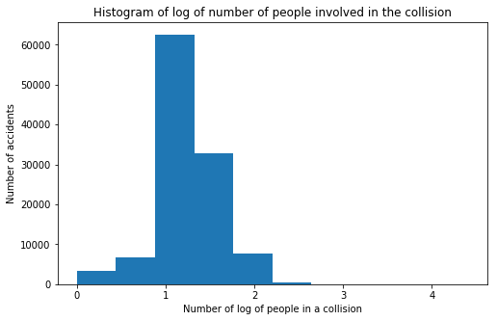
Histogram of log of number of people involved in the collision

Slide 8
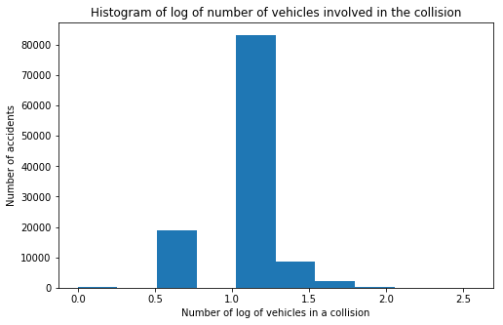
Histogram of log of number of vehicles involved in the collision

Slide 9
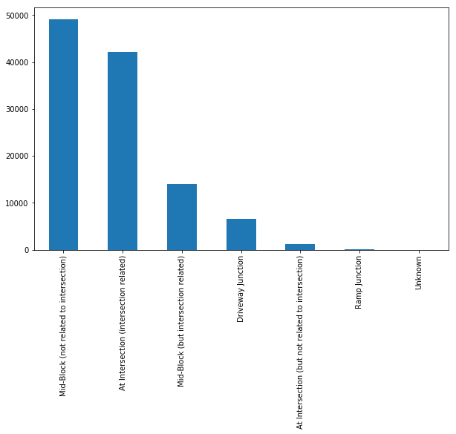
Bar chart for the junction types

Slide 10
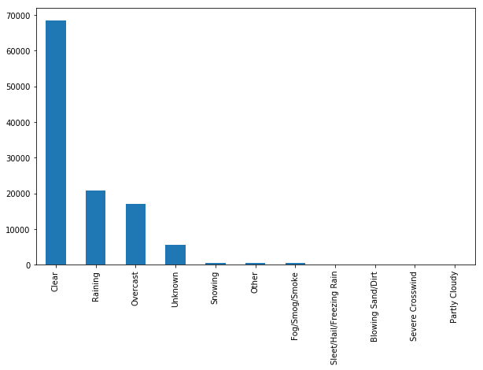
Bar chart for weather types

Slide 11
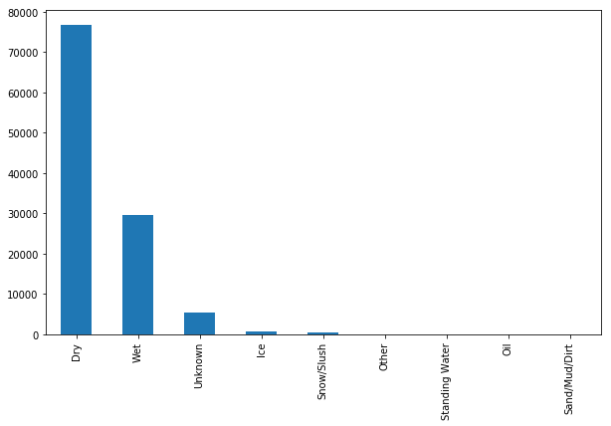
Bar chart for road conditions

Slide 12
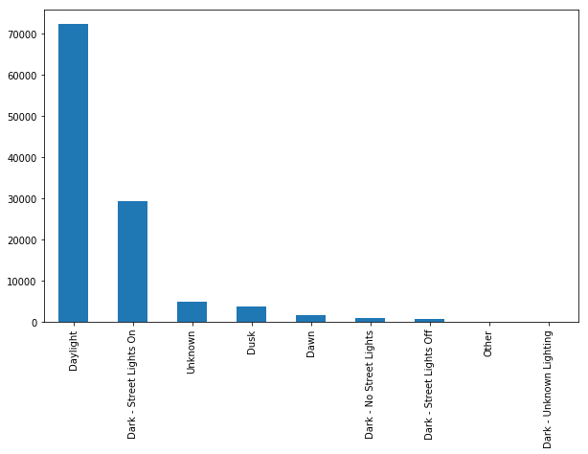
Bar chart for light conditions

Slide 13
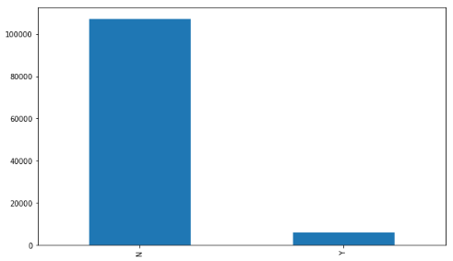
Bar chart for speeding conditions

Slide 14
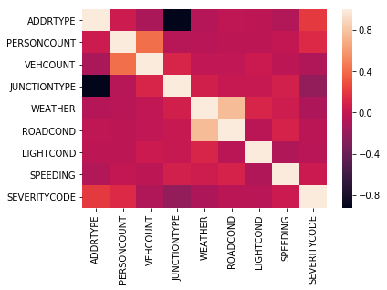
Heat map for the attributes

Slide 15
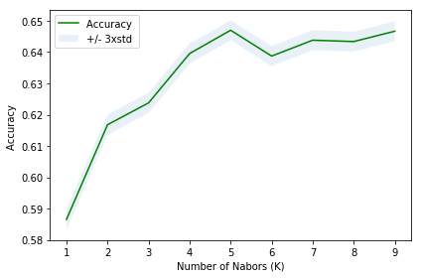
Methodology
Logistic Regression (LR) model
“liblinear” solver
C=0.01
Support Vector Machines (SVM) model
'rbf' kernel
Decision Tree (DT) model
criterion = "entropy“
maximum depth = 4
K-Nearest Neighbors (KNN) model
best accuracy = 0.65
k= 5

Slide 16
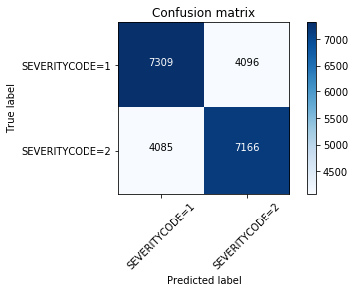
Results
Confusion matrix for Logistic Regression model

Slide 17
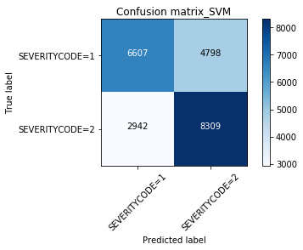
Confusion matrix for SVM model.

Slide 18
Evaluation
 | Jaccard | Precision | Recall | F1-score | Log loss
LR | 0.64 | 0.64 | 0.64 | 0.64 | 0.65
SVM | 0.66 | 0.66 | 0.66 | 0.66 | NAN
DT | 0.67 | NAN | NAN | NAN | NAN
KNN | 0.65 | NAN | NAN | NAN | NAN

Slide 19
The most relevant attributes to the severity of the accidents is the address type. Block has the highest probability for car accidents, followed by the intersection and the alley is the least possible place for car accidents.
Four modes, namely Logistic Regression (LR), Support Vector Machines (SVM), Decision Tree (DT) and K-Nearest Neighbors (KNN), are applied to predict the severity of the accidents. Their performances are quite similar, and decision tree is slightly better than the rest of the models.
Conclusions

